Slide 1
Land Grab Universities
Contributors: Harriet C.P. Lau
Keywords: Native Americans, reparations, American Expansion, Colonialism, Higher Education
Location: United States
People: n/a
Last updated: December 6, 2020
Visit https://geo-context.github.io for the teacher’s companion guide to these slides.

Slide 2
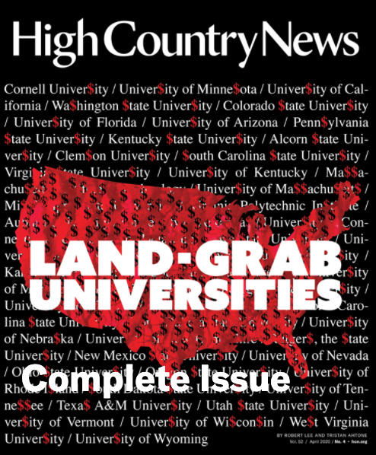
Land Grab Universities
Many of us, maybe sitting here in this lecture hall, have gained directly from the murky business how the federal government acquired land…
https://www.landgrabu.org/
A project by Robert Lee, Tristan Ahtone, Margaret Pearce

Slide 3
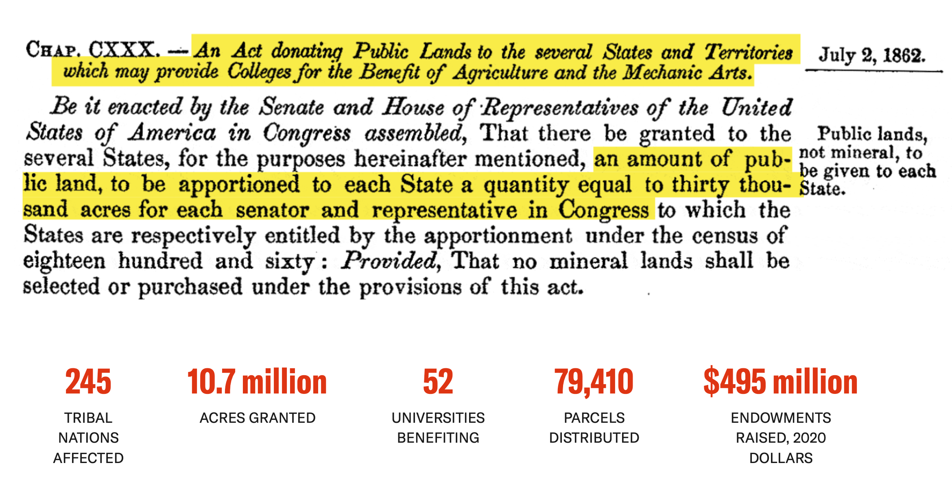
Morrill Act (1862)
Signed by President Lincoln the law distributed public domain lands to raise funds for colleges. Land, taken from tribal nations, was turned into seed money for higher education.
Aim was to broaden access to higher education, but who lost out?

Slide 4
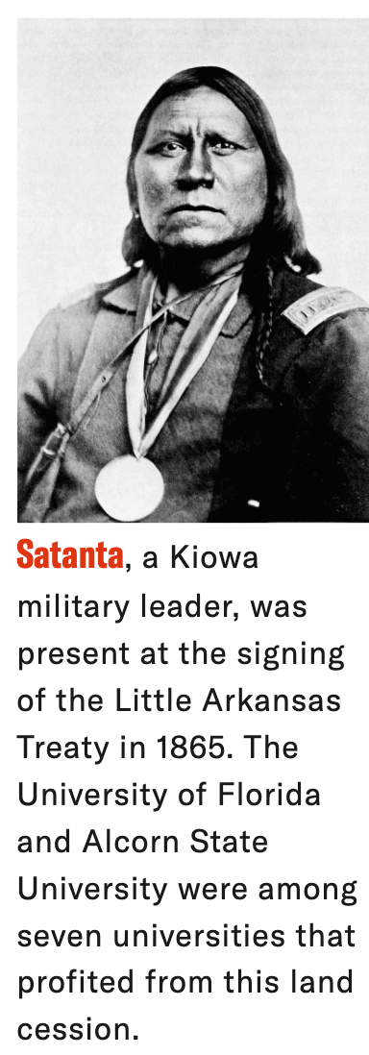
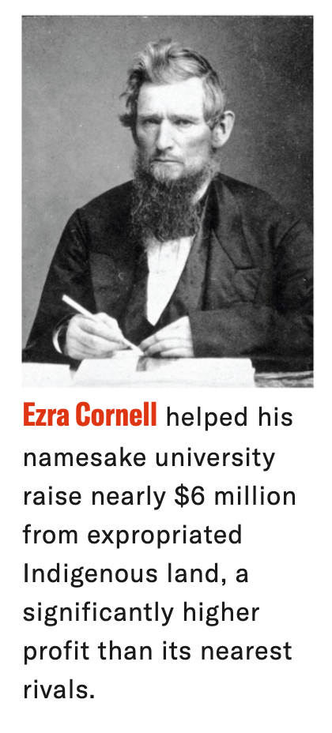
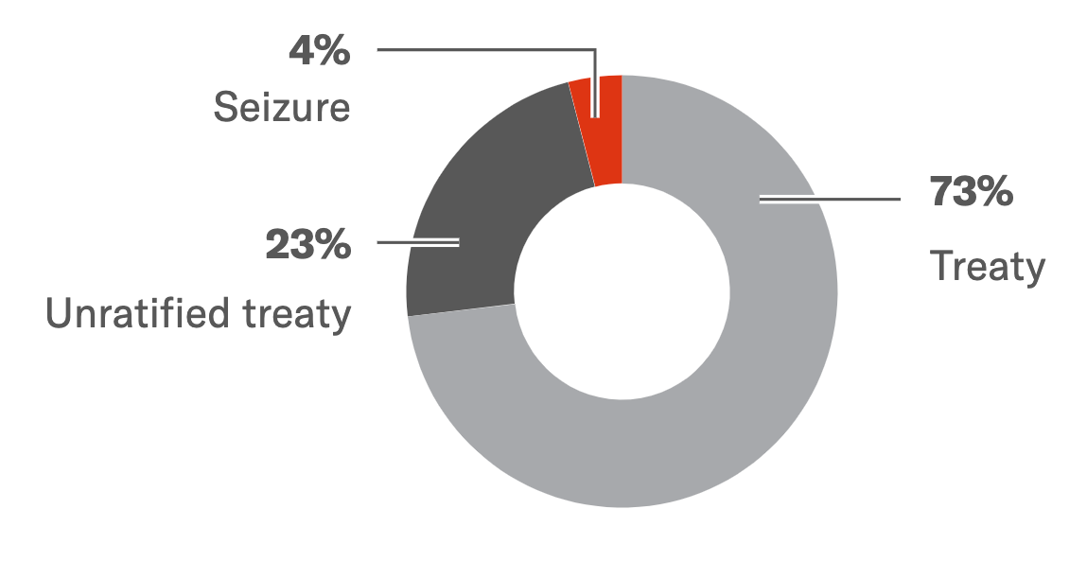
Morrill Act (1862)
Land-grant universities were built both on Indigenous land and with Indigenous land… sometimes these land grants were as large as big cities. Land may have been thousands miles away from the campus that benefited.
Many treaties were backed by violence. 2 billion acres taken in total, 11 million went to 52 land-grant institutions.
How Indigenous lands were acquired by universities

Slide 5
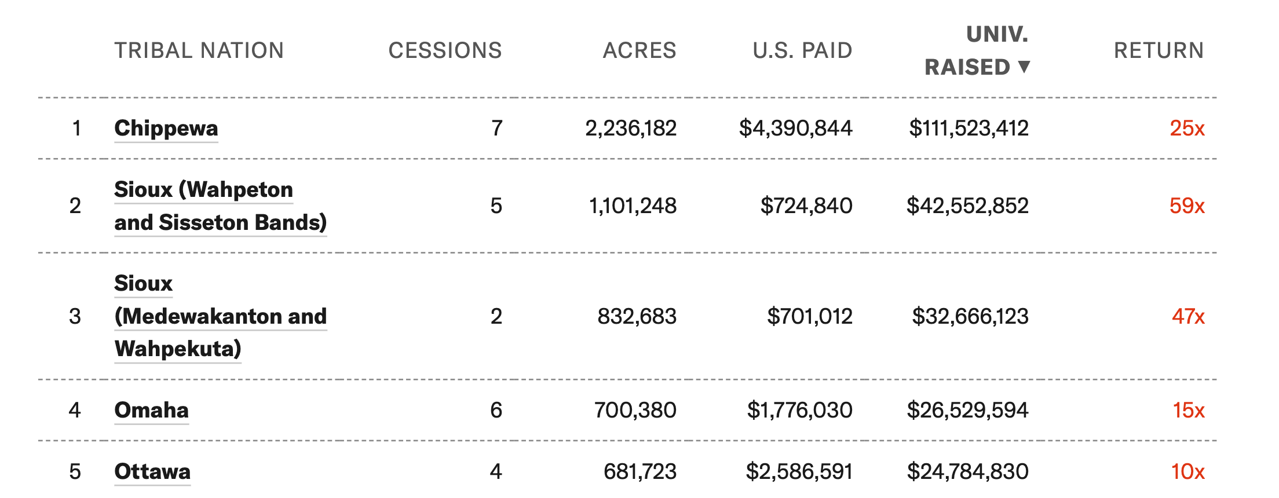
What was taken
In no single agreement did the US federal government pay more than $400,000. More often, no money was paid to remove Indigenous title to land.
Top five tribal lands ceded (adjusted for inflation)

Slide 6
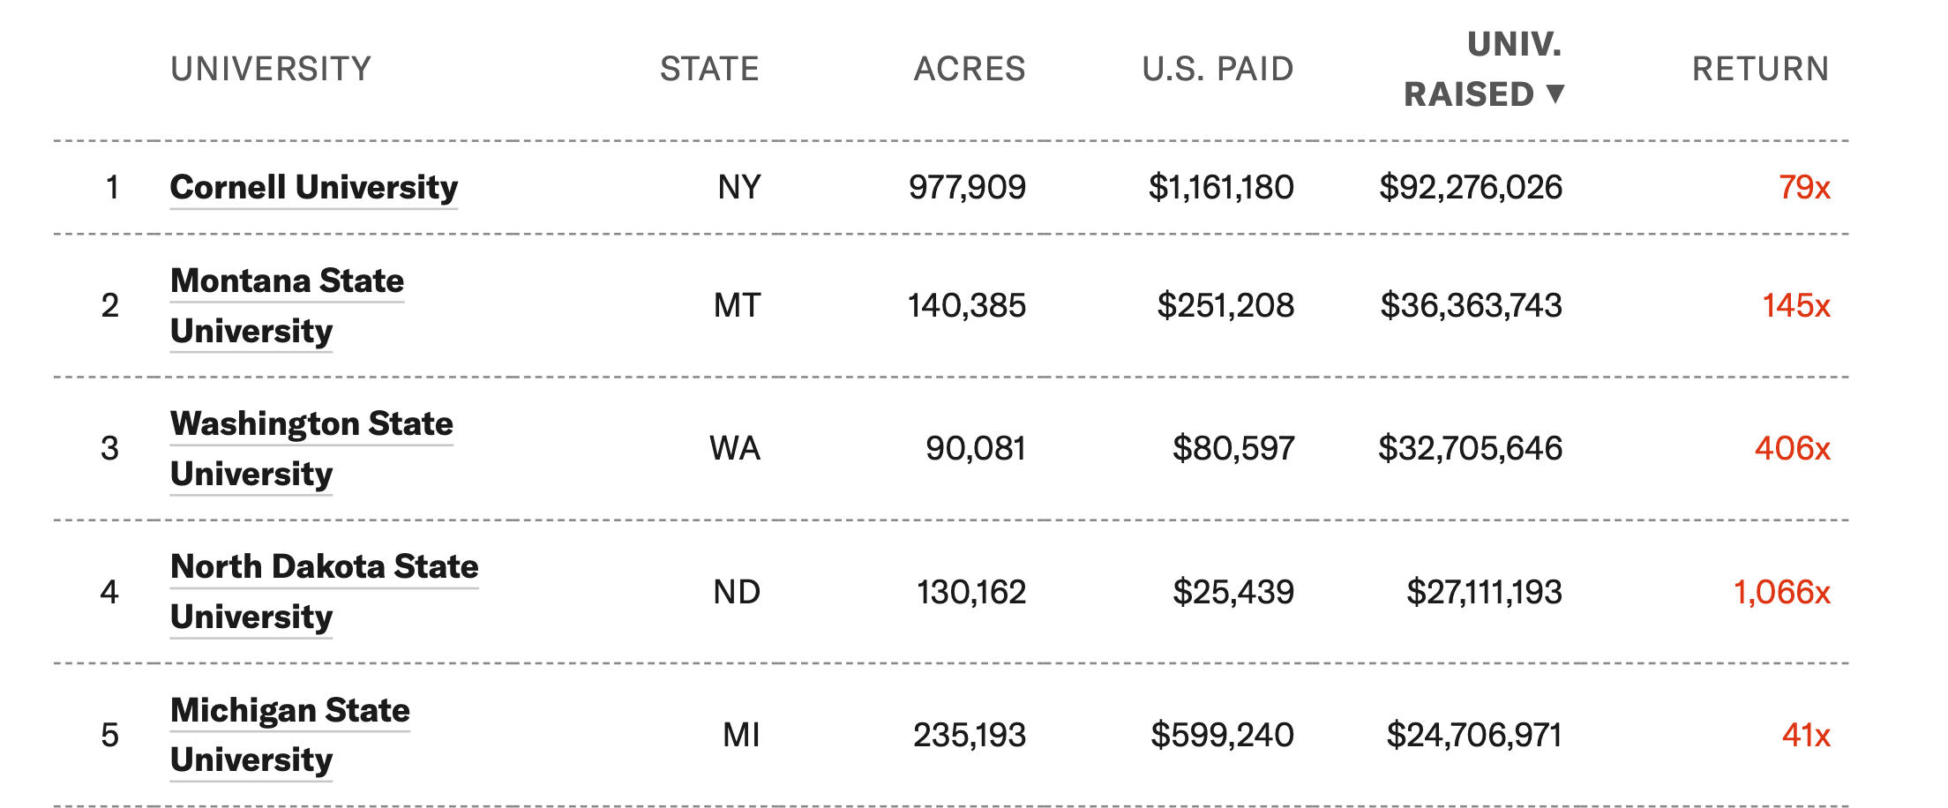
What was gained
All 52 universities have raised $495,132,476 from the lands taken!
Top five universities gaining (adjusted for inflation)

Slide 7
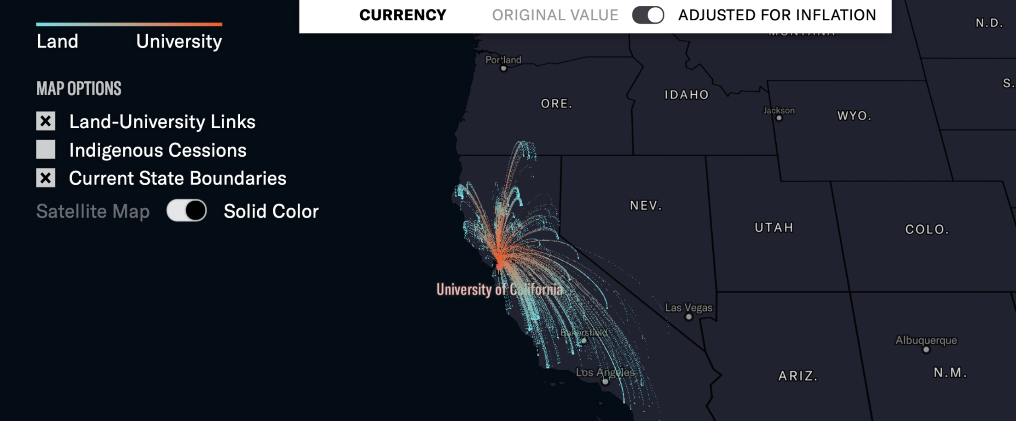
University of California
University of California took 148,636 acres of land and the US paid $0. It is estimated that this is worth $13,399,104 (adjusted for inflation)
In CA: bounties were paid for by the state (and reimbursed by the federal government) for the heads and scalps of Indigenous peoples. 18 treaties were made without compensation.
In 2019, Gov. Gavin Newsom apologizes, noting “It’s called genocide.”
Click on https://www.landgrabu.org/universities for other universities

